Slide 1

WHO WE ARE
RX. Treat Wellness Private Limited is a one-stop medical care solution for people in need of safe, comfortable, and high-quality healthcare facilities along with other wellness services.
We offer a myriad of services including online consultations, medical visas, currency exchange, travel arrangements, hotel bookings, airport pick and drop service, tourism in India, translator service, local phone number, pathology tests and medicines, alternative medicine, and therapies like yoga, ayurveda, homeopathy, and more, post-surgery care, patient nursing care, senior care, rehabilitation facilities for addicts and people with special needs such as dementia or any other health issue and any other personalized assistance as needed by the patient. Our special services also include an RX Privilege Health Card and AYUSH Club (under which we provide AYUSH therapies and treatments).
With years of experience in the industry, we understand the importance of ‘Health to All’ and ‘Health for All’, a phrase we take seriously and work through as the foundation of our business ethics. Our mission is to initiate classless medical assistance that reaches all sections while being effective, high-quality, and affordable at the same time.

Slide 2
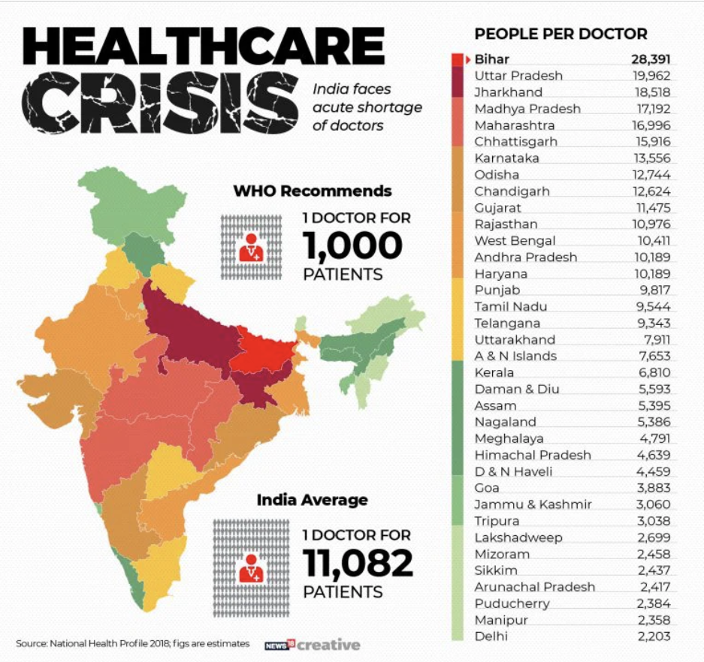
PURPOSE OF THIS PROPOSAL
Working 24*7 around patients suffering from different ailments, belonging to different ethnic groups, living across the globe, and coming from different walks of life, we are extremely proud that despite these differences, they all come under one roof, ‘Our Proud Mother India, to get back to health and return to their normal lives.
However, we cannot escape the fact that India itself faces an unprecedented healthcare crisis in the form of health inequality owing to its rising population pressure, shortages of healthcare professionals, and limited spending capacity of a large part of its population.
65.7% of households in the general category have access to modern, private restrooms.
Improved, private sanitary facilities are available to 25.9% of Scheduled Tribes (ST) homes.
Scheduled Castes (SC) families have 12.6% more stunted children than general category households.
The odds of a child dying before turning five are three times higher for the bottom 20% of the population than for the top 20%.
(Source: Oxfam India’s Inequality Report 2021: India’s Unequal Healthcare Story)
Source: National Health Profile 2018, figs are estimates

Slide 3
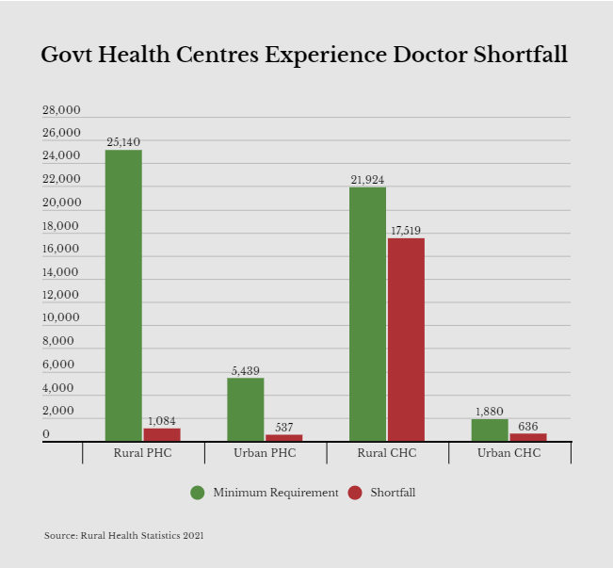

Despite the best and relentless efforts of the government to provide quality health to all through its various health schemes and policies, we as a nation have a long way to go.
According to the 2021 data, despite the fact that over two-thirds of the population lives in rural areas, just 33% of all healthcare professionals and 27% of doctors are accessible there. The scarcity of doctors in Community Health Centres (CHCs) has increased from 45% in 2005 to 80% in 2021 and has stayed steady in Primary Health Centres (PHCs) at 4.3%, despite the fact that the number of health centers has grown in rural areas. Urban PHC and CHC shortfalls are 9.8% and 34%, respectively.
Sharing the vision of our honorable Prime Minister, Shri Narendra Modiji, we believe that ‘New India’ also needs to be a ‘Healthy India’ where its own traditional systems play a key role in providing quality healthcare to its citizens.
AYUSH can play a crucial role in realizing the dream of ‘New India’ by delivering superior healthcare and medical treatment to the citizens.
Source: Rural Health
Services, 2021
Source: Estimation of
National Sample Survey
Organisation (NSSO) and
National Health Workforce
Accounts (NHWA) 2018 data
by Indian Institute of Public
Health

Slide 4


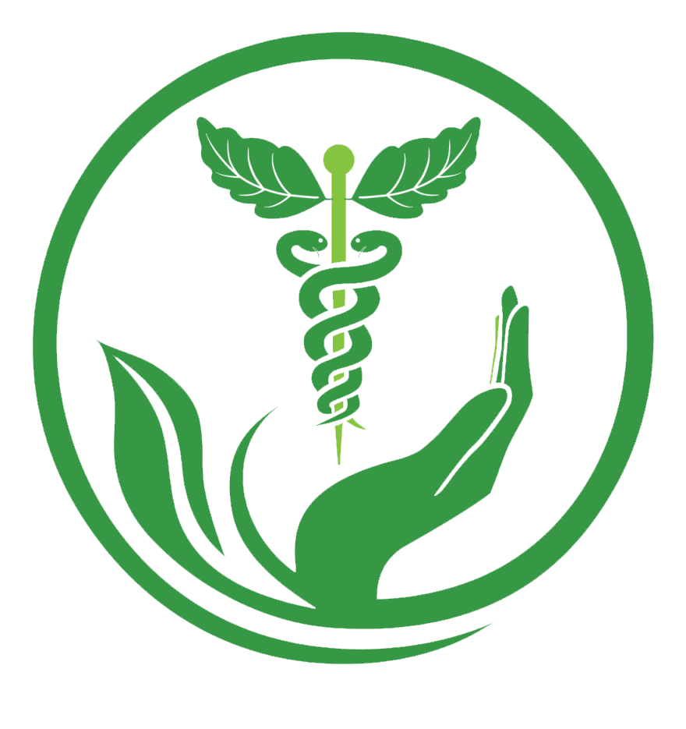


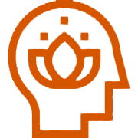


Significance of AYUSH Health Practices
The term "alternative systems of medicine" (AYUSH), which stands for Ayurveda, Yoga, Naturopathy, Unani, Siddha, and Homoeopathy, represents the systems of indigenous medicine traditional to our ‘Mother India’.
AYUSH therapies were in practice even before modern medicine took shape in our culture. It is not simply a fusion of knowledge, skill, and practices but the core goals of AYUSH incorporate the promotion of health, combating disease, and healing illness.
AYUSH practices are not just affordable but also hold centuries-long trust, experience, and recognition for showing positive results, sometimes even when modern medicine fails us. Traditional medicine might not be as popular in metropolitan cities, but small towns and rural regions of India still value AYUSH medicine over allopathy and modern medicine. Not just that, AYUSH has been gaining greater popularity worldwide ever since the benefits of yoga, ayurveda, and other traditional Indian medicines revolutionized healthcare and wellness practices on the world stage.
From yoga ashrams to spas and wellness centers offering holistic therapies, India offers a multitude of sites and locations to retreat, recharge, and rejuvenate. The strong branding of AYUSH by the Government is drawing patients to India from across the world.

Slide 5
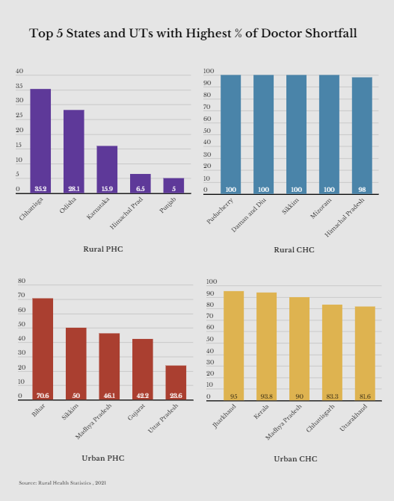
Ayurveda is touching every area of our lives for its healing and immunity-boosting properties. In January 2021, Eureka Forbes, India’s largest water purifier brand, introduced Dr. Aquaguard with Ayurfresh technology that infuses the goodness of seven Ayurvedic ingredients in every glass of water.
Innovative businesses are now introducing ayurvedic herb-based dishes on their menu. A Kolkata sweet shop that introduced ‘immunity sandesh’—infused with 15 herbs & spices including turmeric, basil, saffron, cardamom, and Himalayan honey grabbed headlines recently.
In New Delhi, Rooh offers cocktails and mocktails infused with six flavors of Ayurveda while Daryaganj, an award-winning chain of fine-dining restaurants, offers traditional drinks with jaggery, lemon, and turmeric and a cumin-carom seed herbal tea.
India has a population of 1.353 billion people, but the resources of healthcare professionals, especially when considered per head of population, are limited. This makes the delivery of quality medical care quite a challenge. Additionally, though traditional medicine is recognized globally and is widely popular for illness prevention, treatment, and overall well-being, it is unfortunate that it is yet to achieve such popularity within our country. Hence, it becomes even more important to mainstream AYUSH to facilitate the accessibility and availability of healthcare services for all while promoting good health and affordable medicine to poorer and middle-income households through AYUSH services.
Source: Rural Health Services, 2021

Slide 6
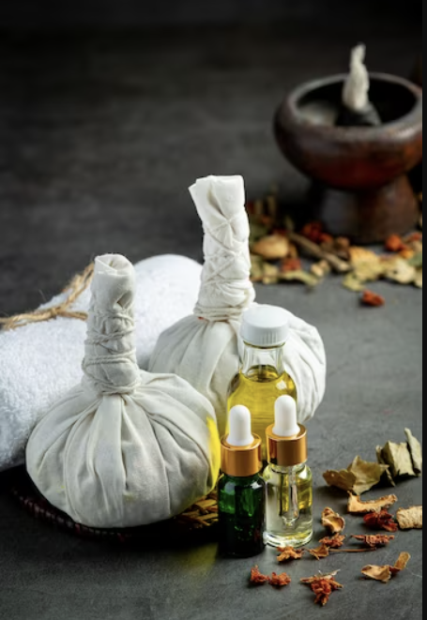
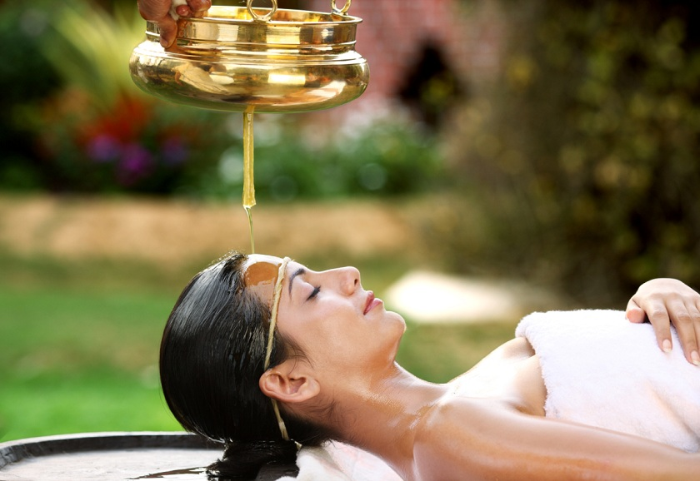
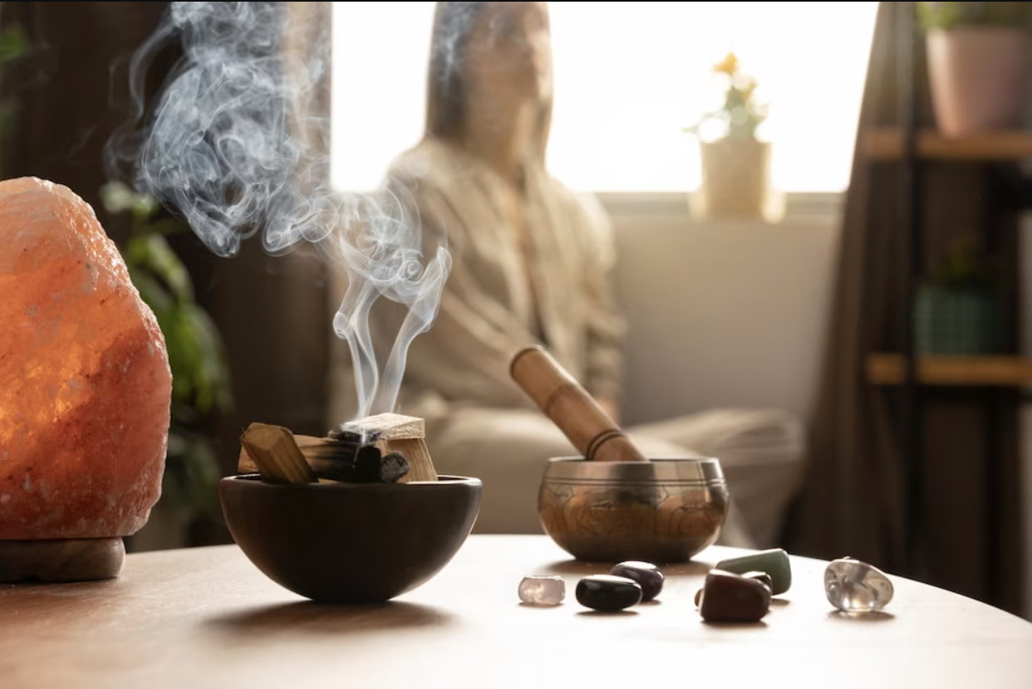

Objectives OF OUR PROPOSAL
Our focus to create an AYUSH CLUB is for various reasons including:
A large number of our patients need post-surgery care for healing both physically and through the anxiety of undergoing surgery. Nothing works better than traditional medicine and practices for this healing process.
A large number of foreigners visiting India for both tourism and treatment are attracted to ayurvedic treatments and therapies, thus AYUSH Club will help us cater to such people.
AYUSH practices are the pride of our Indian culture and being involved in helping it become mainstream even if in a small way makes us feel proud as Indians.
AYUSH medicines and practices are as effective but more affordable as compared to allopathy and Western medicine. This will help us reach out to the lesser privileged section of Indians who do not get proper healthcare due to a lack of funds.

Slide 7
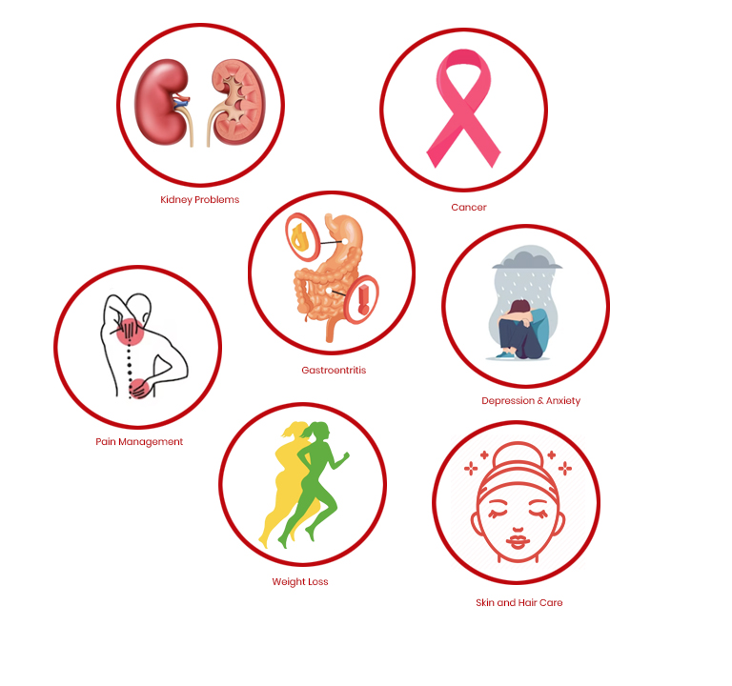
Allopathy and Western medicine are quick cures for any ailment. AYUSH on the other hand heals from within. Thus, more people are drawn to it. As a health-tech company, we would like to grab this audience.
AYUSH practices can heal severe ailments like kidney issues, cancer, gastroenteritis, and more even where allopathy fails. We are already collaborated with such Ayurvedic clinics that heal patients using traditional medicines and practices.
We have already helped patients heal through traditional medicine who were once recommended liver transplants and other surgeries stating there was no other way out. This gives us firsthand experience about the effectiveness and faith in AYUSH. Thus, giving us more reasons to have a separate AYUSH CLUB under our wing.
AYUSH medicines do not only work effectively for patients with complicated problems like gastroenteritis, liver and kidney issues, eyesight problems, arthritis, and more, but it also provides solutions to life-threatening diseases like cancer that science still hasn’t had an absolute solution to.
Ailments AYUSH practices can heal

Slide 8
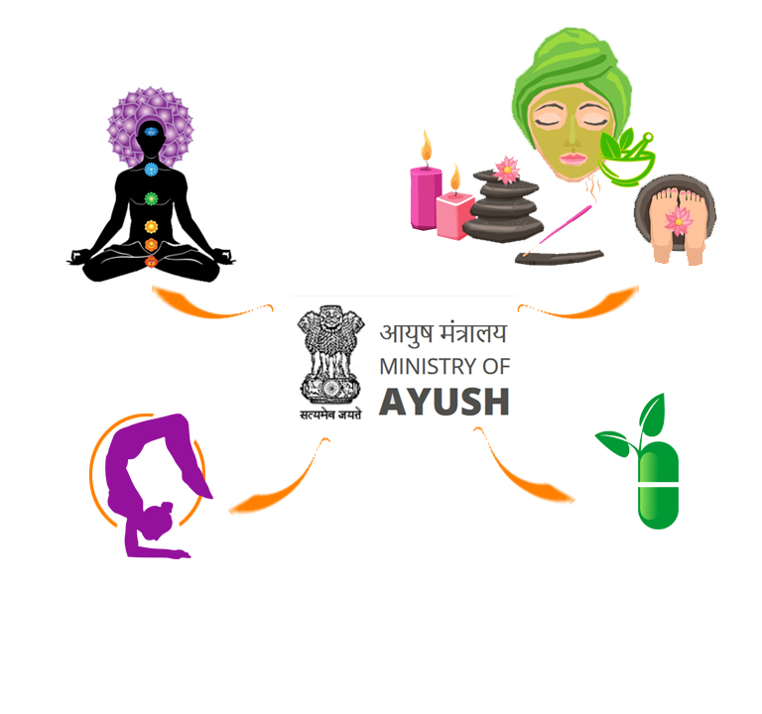
The government’s plan to promote AYUSH medical tourism with the theme – ‘Heal in India’ is a big opportunity for us to not only grow as a business but to promote the traditional medicine market on a global scale.
According to the report ‘The Global Wellness Economy: Looking beyond COVID’ by the Global Wellness Institute (GWI), Ayush based healthcare & Wellness economy is estimated to grow to $70 billion by 2025.
India is the global leader in Ayurveda, naturopathy, and yoga. A large number of foreign tourists come to India for these particular getaways. This has a huge client base, especially from America and European nations.
With the millennials shifting towards a healthy Ayurveda-based approach, the Indian wellness and Ayurveda sector is on its way to impacting the lives of millions of people on a domestic and international level. We would not like to miss out on such a potential client base.
Unani practices are considerably preferred by the Muslim communities. This helps us cater to a large part of our patients and tourists, especially from Bangladesh and other Muslim regions who travel to India for treatments, as well as those who are on vacation but interested in lifestyle wellness therapies.
Foreign National attracted to India for AYUSH Gateways

Slide 9
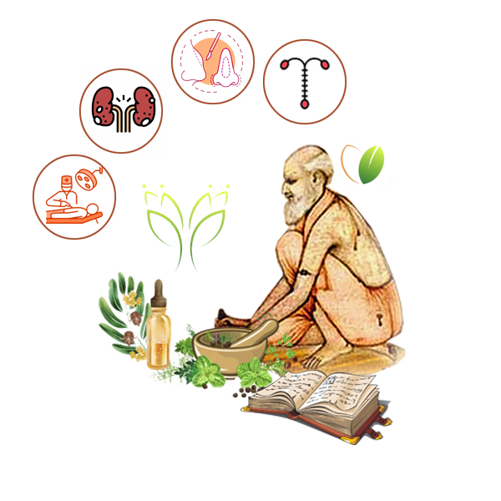
History of AYUSH Medicines
AYUSH therapies, which have their origins in the Indian subcontinent, evolved and developed over two millennia.
In addition to herbal remedies, specific diets, yoga, massage, laxatives, enemas, and medical oils, ancient Ayurvedic literature also taught how to perform surgeries such as rhinoplasty, kidney stone extractions, stitches, and the removal of foreign objects from the human body.
Ayurveda incorporates all facets of life - the physical, psychological, spiritual, and even social. It has a history
of at least 5300 years, first mentioned in Mahabharata. Unani on the other hand, works based on the disparities between specific fluids in the human body, such as bile and blood.
In order to maintain health, Siddha focuses great value on balancing the environment, weather, exercise, and stress. While homeopathy is a growingly popular approach that is gaining popularity worldwide, it takes a holistic approach through the promotion of internal harmony on the mental, emotional, spiritual, and physical dimensions of a sick person.
Ayurvedic literature taught how to perform surgeries such as rhinoplasty,
kidney stone extractions, stitches, and more

Slide 10
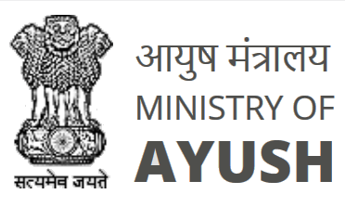
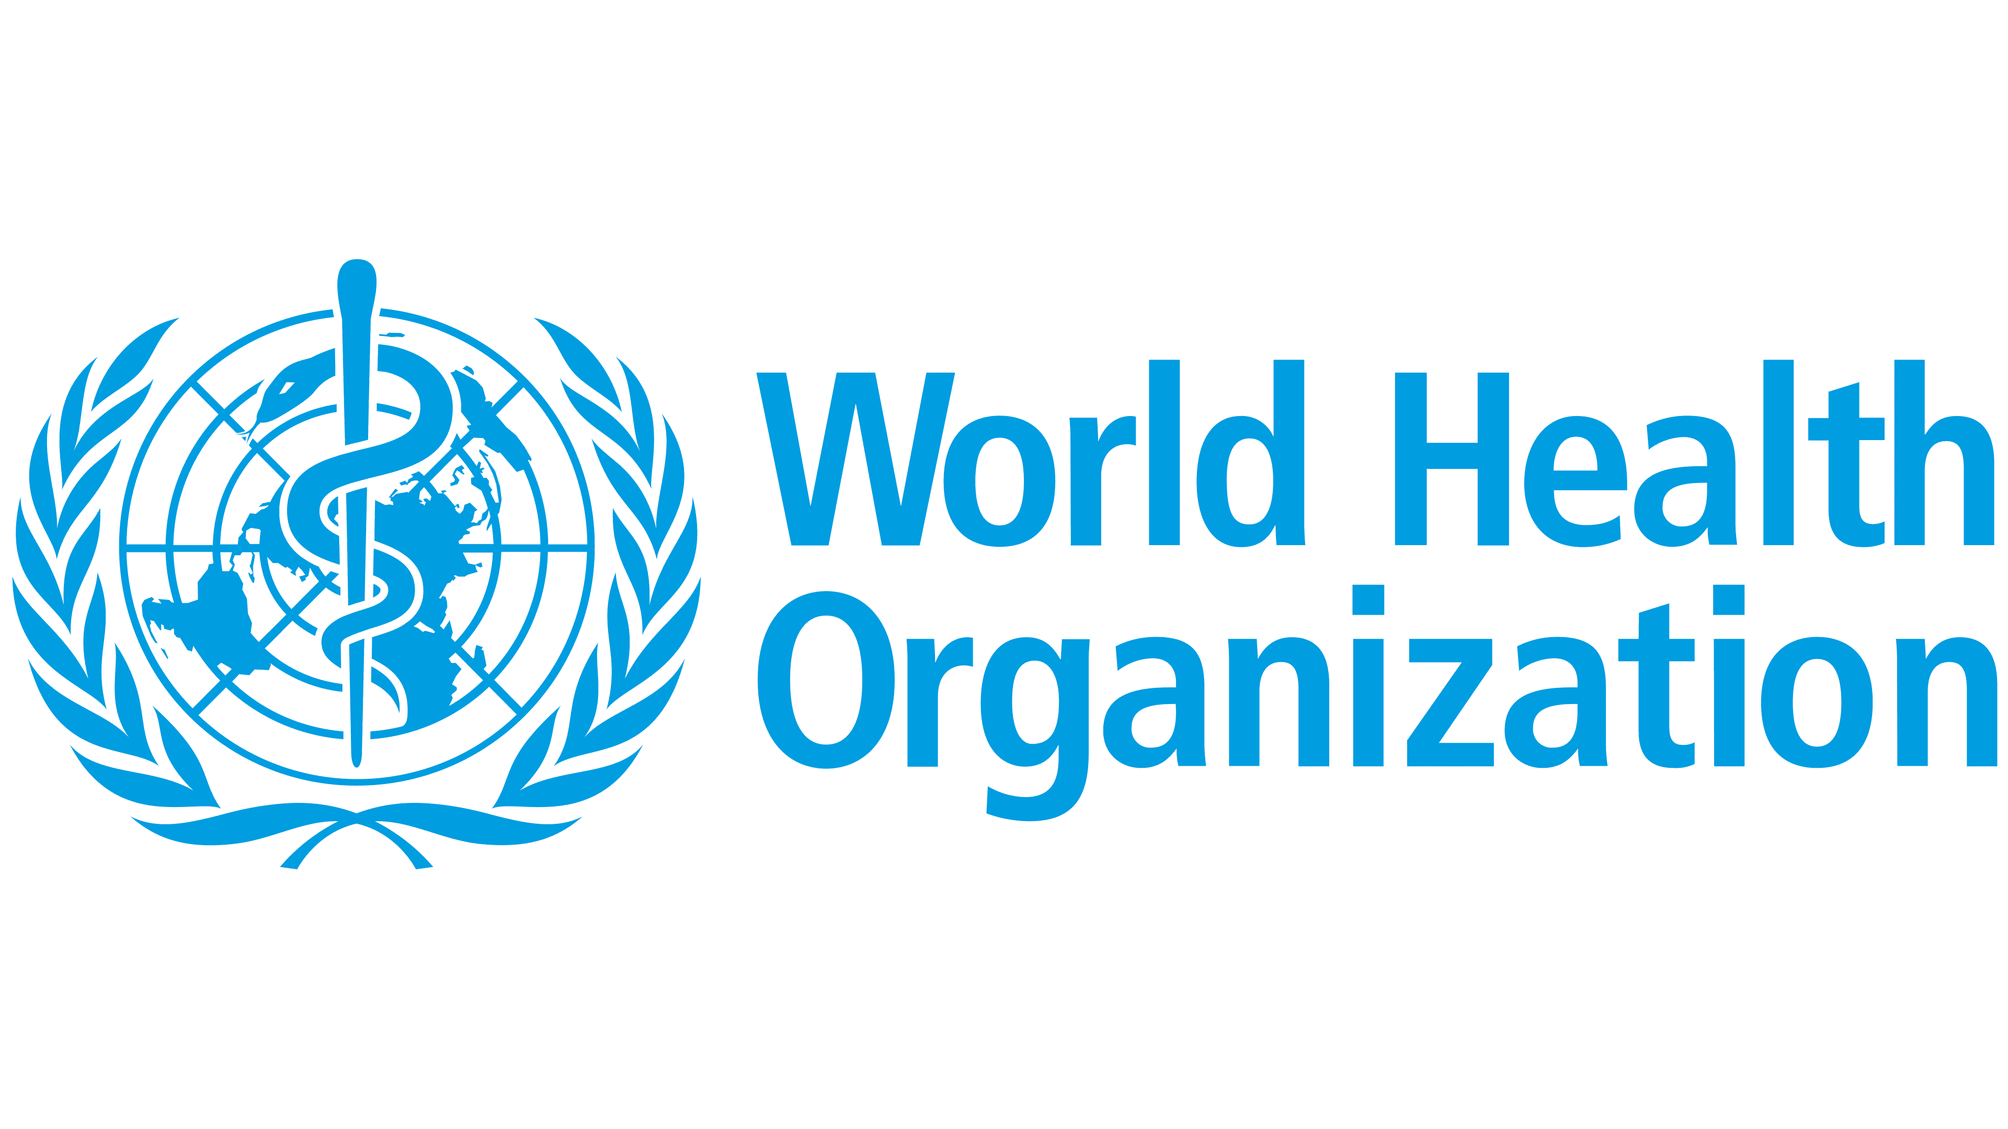
Integration of AYUSH in Healthcare of different countries
Thanks to the persistent efforts of the Ministry of AYUSH (MOA), Ayurveda is now recognized as a medical system in 16 nations, including Hungary, Switzerland, Cuba, Brazil, Nepal, Sri Lanka, Pakistan, Bangladesh, UAE, Oman, Saudi Arabia, Bahrain, Malaysia, Mauritius, Serbia, and Tanzania. Five nations in the European Union (EU) have laws governing ayurvedic medicine: Romania, Hungary, Latvia, Serbia, and Slovenia. Bangladesh recognizes the Unani system, and Sri Lanka accepts the Siddha system.
The Ministry of AYUSH (MOA) and the World Health Organization (WHO) are establishing the world’s first and only Global Centre for Traditional Medicine (WHO GCTM). By fusing traditional medicine with cutting-edge technology and scientifically sound research, the center seeks to maximize its potential. To maximize the contribution of conventional medicine to global health, the GCTM will concentrate on four core strategic areas: evidence and learning, data and analytics, sustainability and equity, and innovation and technology.
The 67th World Health Assembly resolution on traditional medicine is a crucial step in the development of updated WHO Traditional Medicine Strategy (2014–23) that aims at harnessing the contribution and promoting the effectiveness
of traditional medicines.

Slide 11
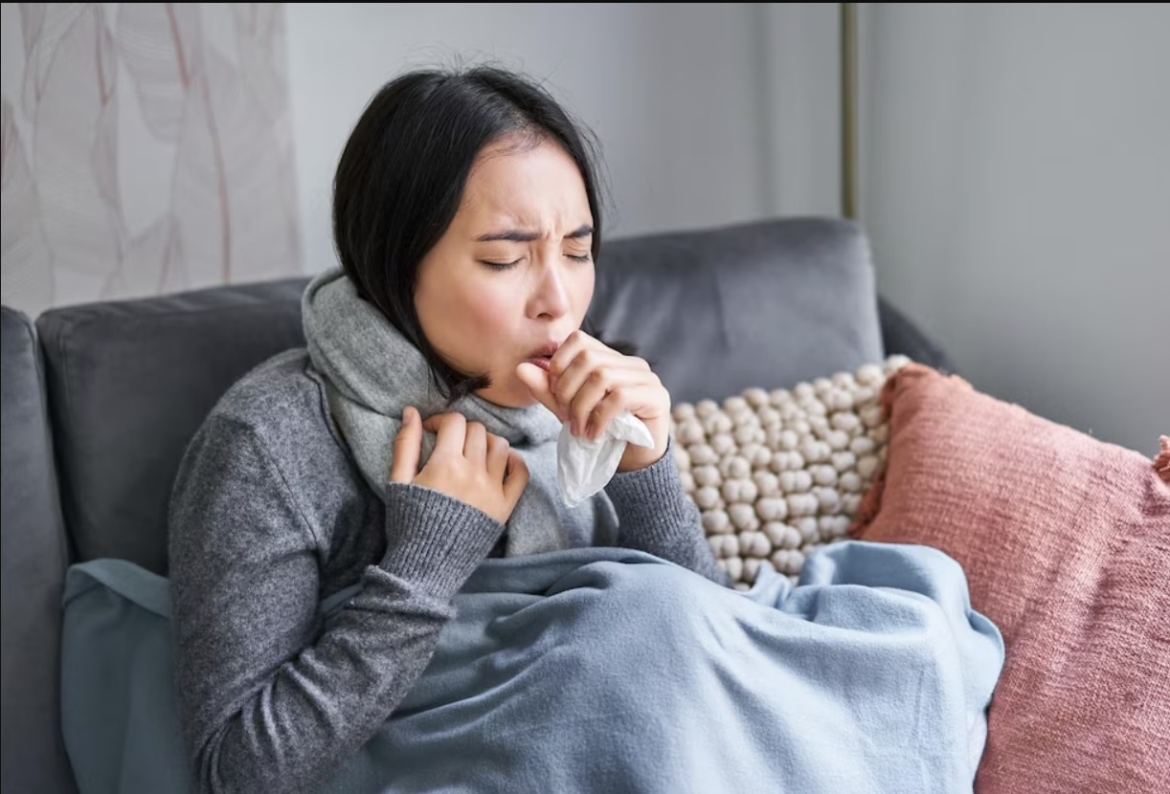
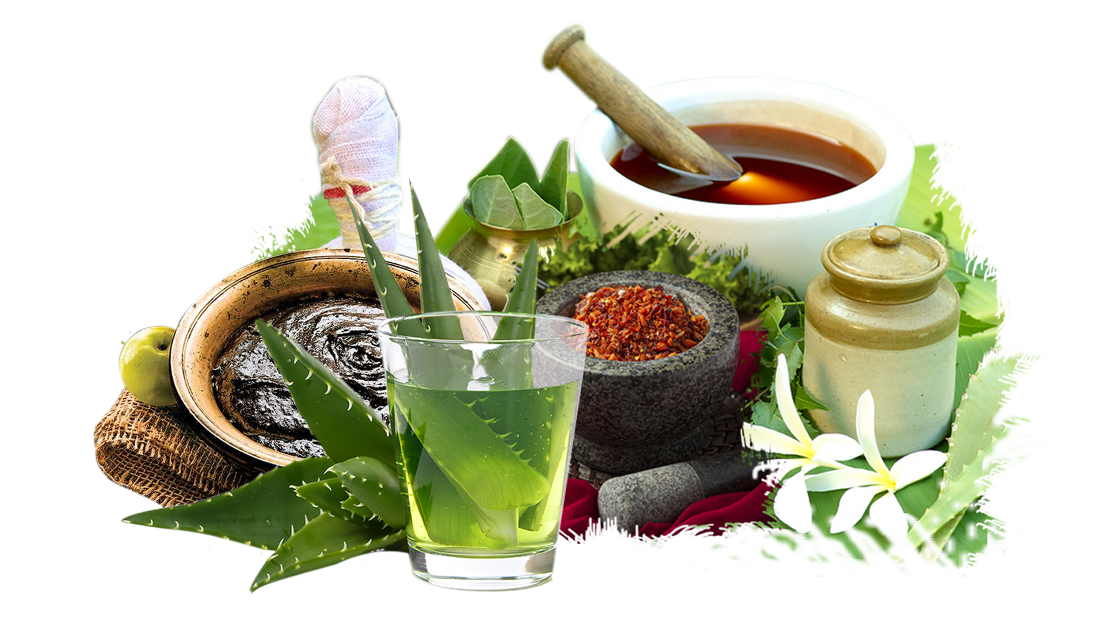
Instances and studies that demonstrate the effectiveness and safety of AYUSH practices
Several clinical trials being conducted across the US are evaluating the effectiveness of Ayurvedic medicine as a potential COVID-19 treatment. Also, the United States is assisting India in these trials.
In one such trial, it turned out that COVID-19 patients taking Ayurvedic treatment saw a faster resolution of their symptoms than those using traditional drugs with government approval. A combination of the Ayurvedic treatment "Immunofree" and the dietary supplement "Reginmune" was given to half of the trial patients. This group consumed one Reginmune (750 mg) capsule twice daily for 10 days, along with two Immunofree (500 mg) tablets three times daily. On day 10, all patients given Immunofree and Reginmune tested negative, while only 88% of the group undergoing conventional treatment did.
Covid-19 Treatment with Ayurvedic Medicines

Slide 12
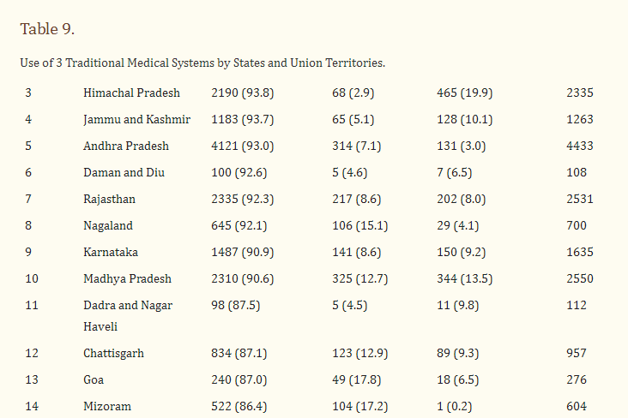
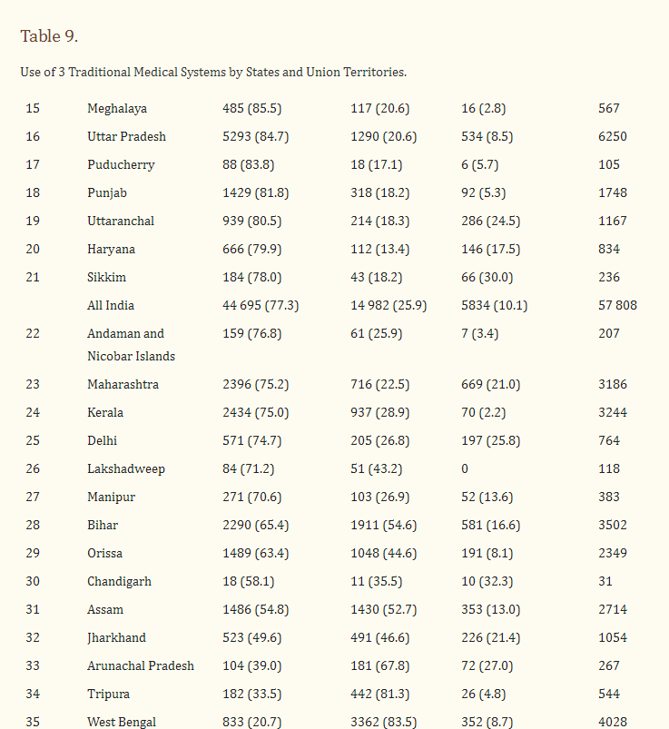
According to the National Sample Survey Organization’s Perception Survey on the Use of AYUSH, less than 30% of Indian households use traditional medical systems. Indian homes are the primary source of medications in the traditional medicine system while the private sector is the chief source in homeopathy. The vast majority of AYUSH patients are also convinced of the efficacy of these age-old treatments. The Ayurveda in Kerala, Siddha in Tamil Nadu, and other types of Indian medicines are evidence that India has an extensive range of medical systems.
According to another study by the Delhi-based All India Institute of Ayurveda (AIIA), Ayush kwatha, Sanshamanivati, Fifatrol pills, and Laxmivilas juice are four Ayurvedic therapies that can be used to treat mild to moderate COVID-19 infection.
In a test on a 30-year-old male health worker with COVID-19 infection, AIIA Doctors found that these treatments not only improved the patient's condition but also turned the fast antigen test negative within six days of treatment.
Use of 3 Traditional Medical Systems by States and Union Territories

Slide 13
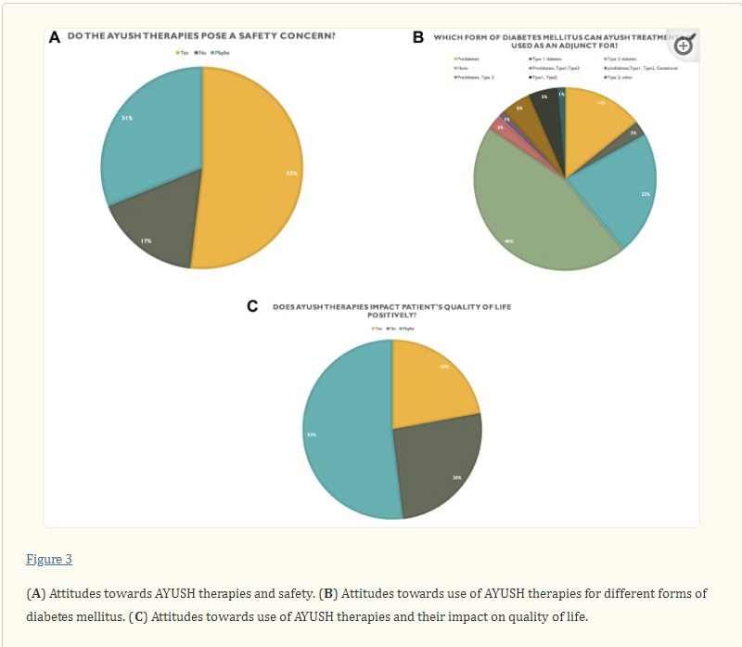
Drawbacks of AYUSH that prevent its inclusion in Conventional Medicine
Though effective, there are a few drawbacks that deter AYUSH medicines from inclusion in the world healthcare system.
The main factor that is preventing AYUSH therapies from becoming mainstream management options is a lack of scientific evidence. A survey was conducted across Mumbai with 77 physicians, including those specializing in diabetes. Most doctors believe AYUSH treatments are unsafe for patients and ineffective for treating diabetes mellitus in any form.
Since there are no established parameters for stability, it is one of the most important issues pertaining to AYUSH formulations. A meticulously developed stability protocol that includes details on the selection of batches and samples, test features, methodology, conditions of storage and period, etc., is crucial to consider.
A fusion of modern technology with ancient knowledge is the need of the hour to popularize Ayurveda through enhanced diagnostic, preventative, promotional, and therapeutic methods.

Slide 14
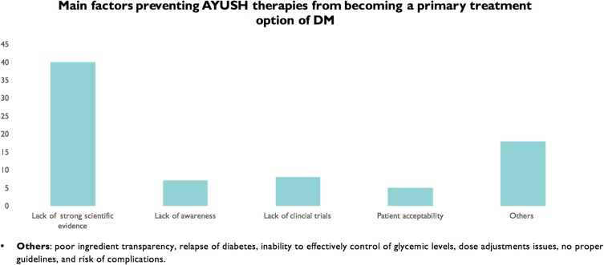
To mainstream AYUSH therapies into public health systems, it is crucial to introduce innovations while working with significant health entities.
Dr KR Antony, Former Health & Nutrition Specialist for UNICEF and Former Director, State Health Resource Centre, Chhattisgarh, said the WHO parameters are "globally applicable for comparative assessment, and so in India, "AYUSH doctors cannot be treated at par with MBBS doctors in the total figure".
If the head of the home is self-employed or a regular income earner, the proportion of households adopting AYUSH is somewhat higher. This can be as a result of the higher affordability of AYUSH for these households. Additionally, compared to households of Hindu and other religions, Muslim and Christian households use AYUSH less frequently. One of the potential causes of this behavior is the religious foundation of certain traditional medicines. Hindus use many traditional medical practices like Ayurveda, Siddha, and Yoga, while Muslims use Unani as a traditional medical treatment. Since Christians in India did not develop an individual form of traditional medicine, they rely on Indian healthcare systems.

Slide 15
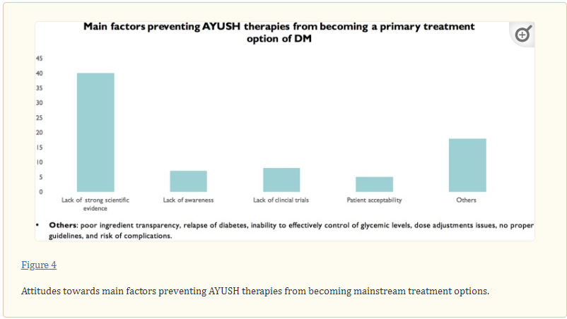
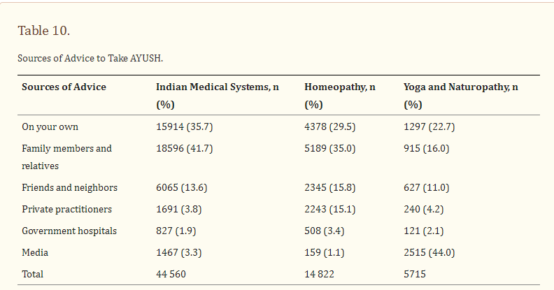
It is unfortunate that AYUSH professionals face prejudice in our country. They are dismissed, saying that they are uneducated in modern science and don't engage in any research. Ayurveda and Yoga need to be introduced in modern medical schools and Universities to promote holistic medical practices based on new models of medical education.
Some Ayurvedic medicine products contain herbs, metals, minerals, or other substances that could be hazardous if taken incorrectly or without the guidance of an authorized practitioner. At present, there is no national standard for Ayurvedic training or certification in the United States, nor are Ayurvedic practitioners required to hold a license. Moreover, The United States regulates ayurvedic medications as dietary supplements rather than drugs.
According to a nationally representative cross-sectional survey on Social Consumption: Health (Schedule 25.0, 71st round, January–June 2014), which covered the whole of the Indian Union, the overall share of AYUSH medicines in total medical expenditure for outpatient care is 4.5% and 4.7% for rural and urban India, respectively. The total expenditure on AYUSH medicine accounted for about 6% of the total medicinal (drug) expenditure for outpatient care, and only 1.5% of patients received free AYUSH medicines during outpatient care, whereas about 12% of patients received free allopathic medicines from public health facilities.

Slide 16
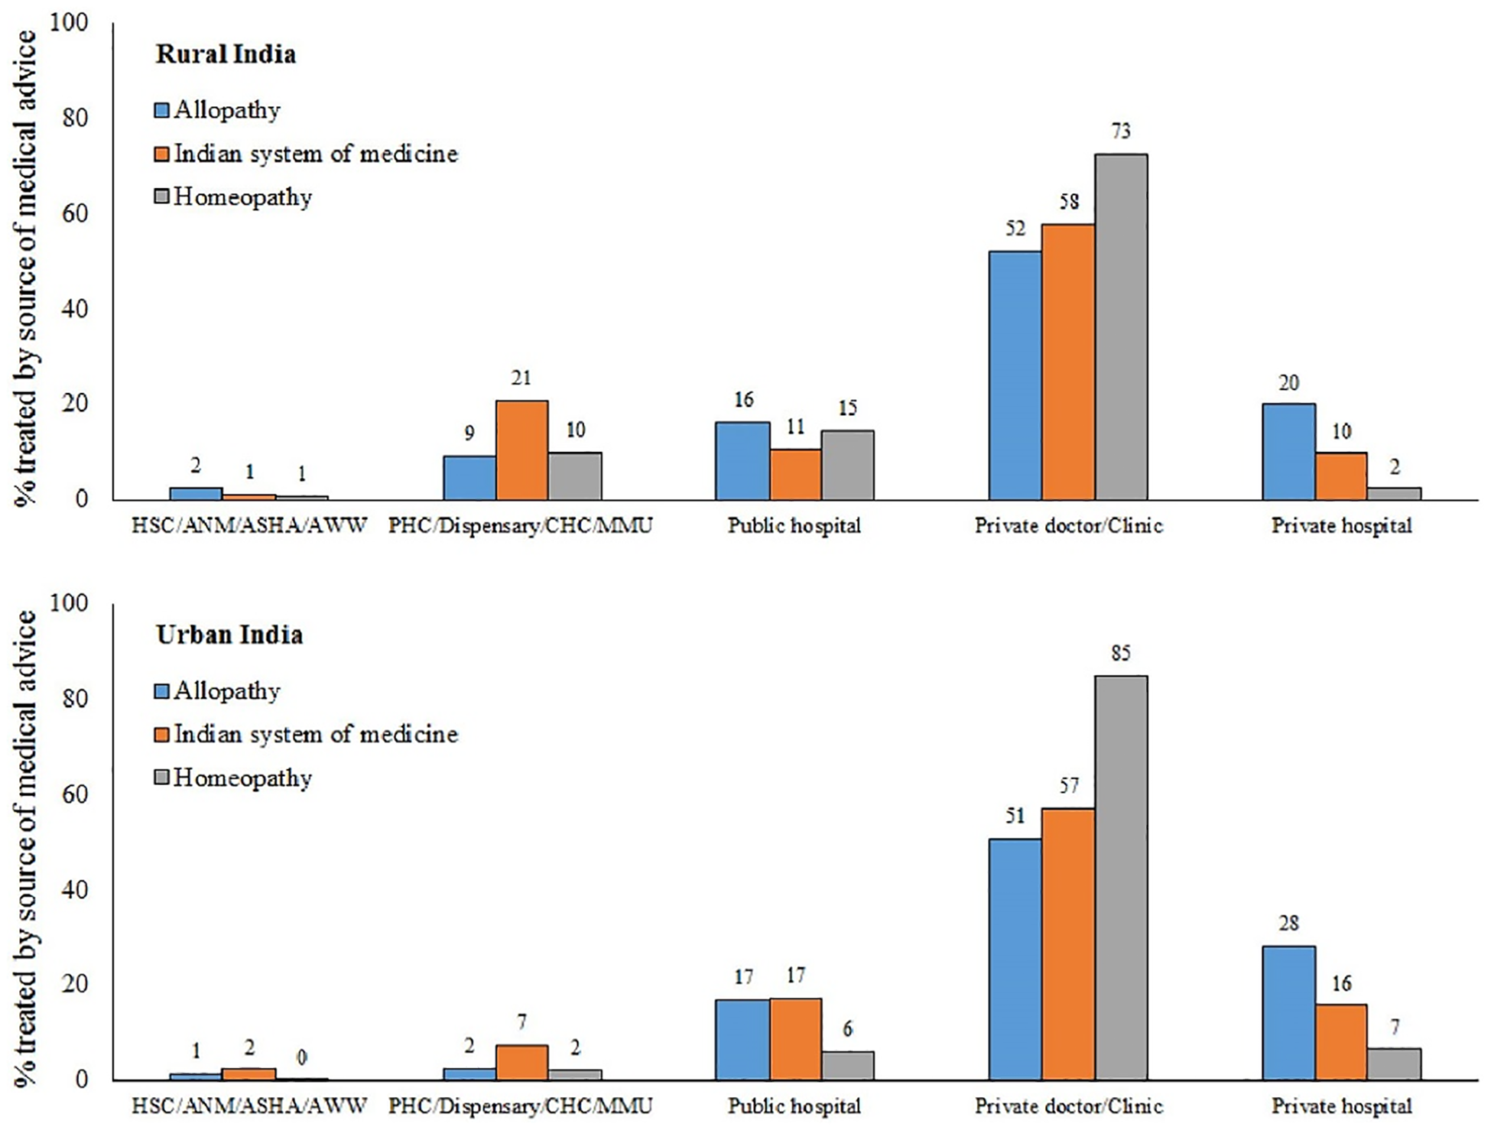
Necessary Actions that will help integration of AYUSH in mainstream healthcare practices
AYUSH therapies can have positive effects when used as a complimentary treatment alongside standard, conventional medical care. It shouldn't, however, take the place of regular, traditional medical treatment, especially when treating serious diseases.
The distribution of medicines to weaker sections under govt. schemes both in urban and rural areas is done by private hospitals, public hospitals, private doctors and clinics, health centres, dispensaries, and community health workers such as auxiliary nurses and midwives at Health Sub Centres (ANM/HSC), accredited social health activists (ASHA), and anganwadi workers (AWW). The government should implement methods to promote traditional medicine under such schemes.
The government should promote yoga, ayurvedic treatments and therapies as well as AYUSH practices for post-surgery care as part of their tourism tactics both on a state and international level to attract more people towards traditional medicine systems.

Slide 17
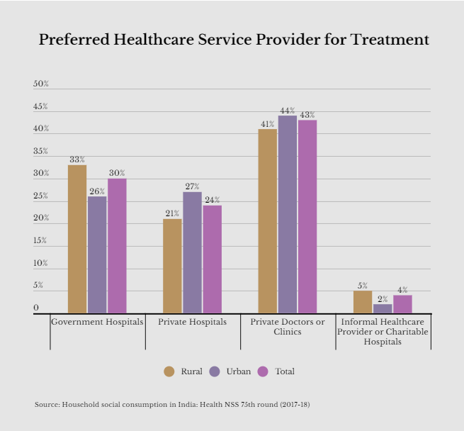
4. Promotion of certification courses in AYUSH therapies and educational courses in schools and universities can help promote the cause.
5. Promoting AYUSH departments in hospitals will not only help build trust in traditional medicines but also bring more awareness to their availability and benefits.
6. Special educational programs based on AYUSH can be conducted in schools and rural areas to raise awareness and educate the masses on a larger scale.
7. Inviting professionals from other countries to study the AYUSH practices as well as encouraging foreign exchange students to certify in a degree course to become qualified Ayurveda doctors can prove to be a stepping stone in lessening the gaps preventing AYUSH from going mainstream.

Slide 18
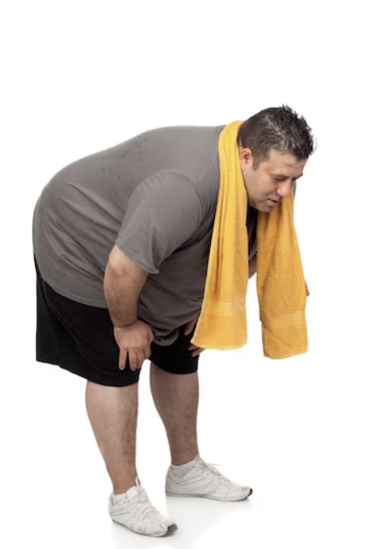

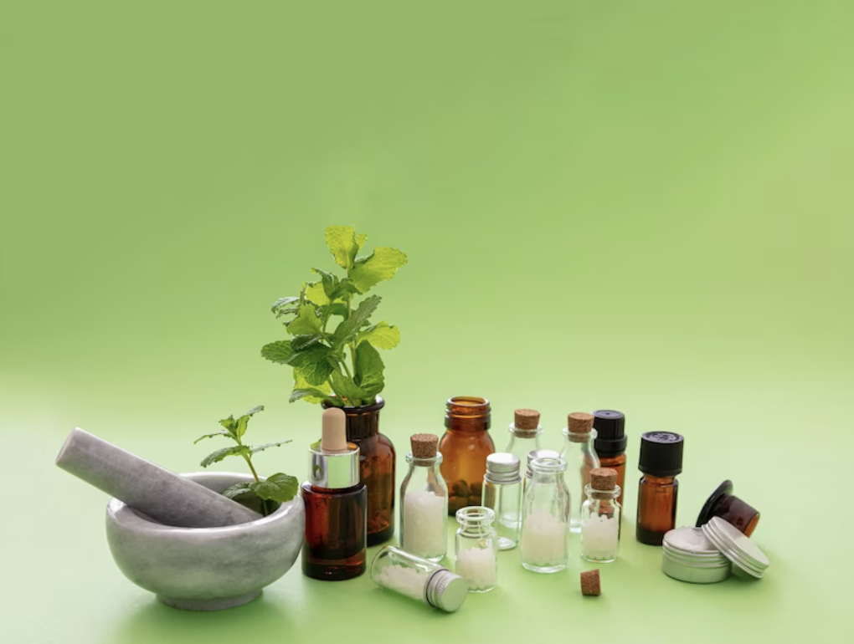

Efforts we have undertaken to promote AYUSH both in India and foreign nations
We are working in close cooperation with the best Ayurvedic clinics across India that provide treatments for kidney issues, obesity, detoxification, mental health problems, depression, and more.
We promote traditional medicine to our patients, both domestic and international, and have success stories as first-hand experience.
We suggest patients with chronic kidney issues who have been suggested transplants also receive consultations at the Ayurvedic clinics offering treatment for kidney problems. For patients whose transplant is the only option, we recommend they get consultation from an experienced Ayurveda Doctor specializing in kidney treatment and if need be, undergo the Ayurvedic medicine course to improve their immunity and blood count during the time period they prepare for the critical surgery and arrange for money as well as a donor for the transplant. This entire process is strictly done under the guidance of practiced professionals after proper consultations between the doctor and the patient.

Slide 19

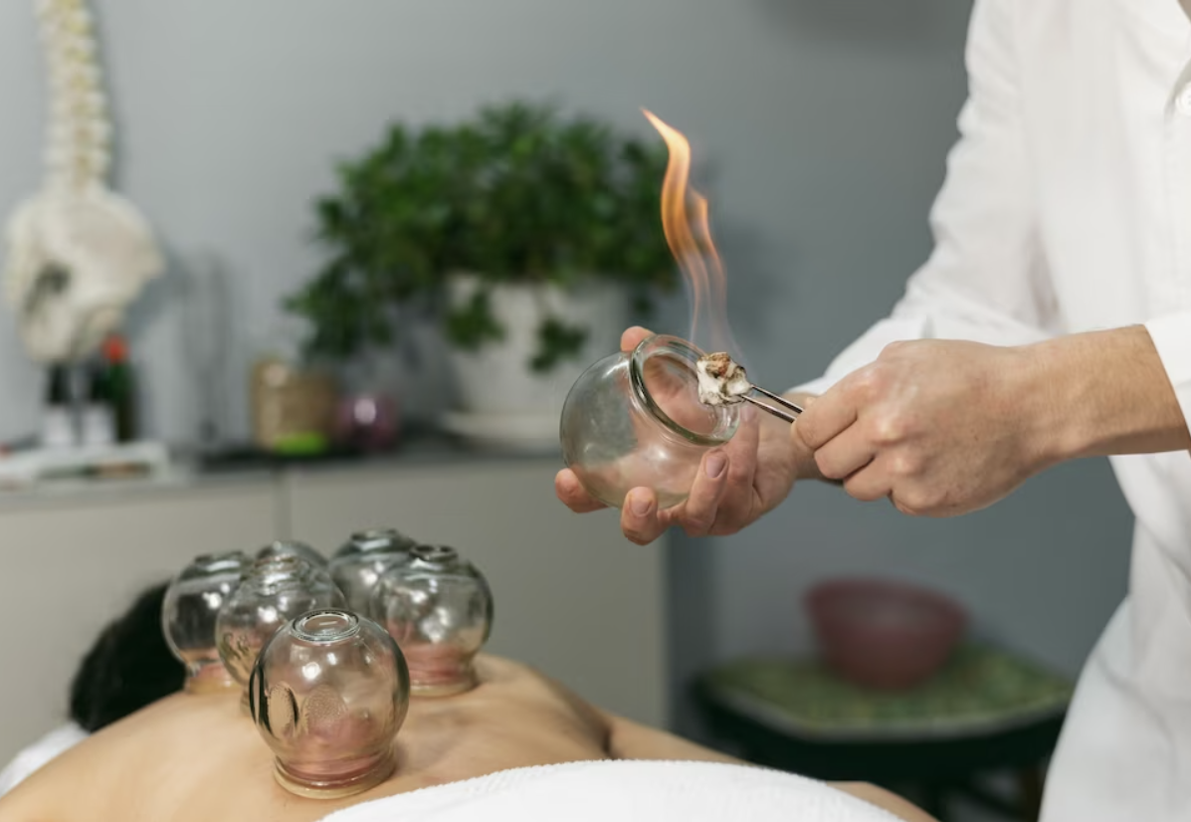
4. We have included AYUSH treatments like pain management through Ayurveda, Ayurvedic treatments for skin and hair, anxiety, and depression, meditation, yoga, and naturopathy in our post-surgery care for patients who stay back longer in India after the surgery to heal their mind and body. This has really helped patients heal both physically and mentally. Even the close relative accompanying the patient at times have taken these therapies for their own well-being.
5. We arrange yoga and meditation sessions for corporate employees to promote stress management in work cultures across India. These are paid sessions and include different programs based on the requirements of the corporates.
6. The above program is also arranged for school children to promote stress management, depression, and anxiety control, confidence building, and overall welfare of the students and teachers.
7. We arrange online consultations for domestic and international patients with Ayurvedic doctors for their issues. This helps build confidence in the patient about opting for alternative medicine treatments for their health problems.
8. We offer packages for Ayurvedic massages, facial treatments, spas, healing therapies, and meditation to our international tourists coming to India for a vacation.
Range of AYUSH Therapies provided to patients and tourists

Slide 20
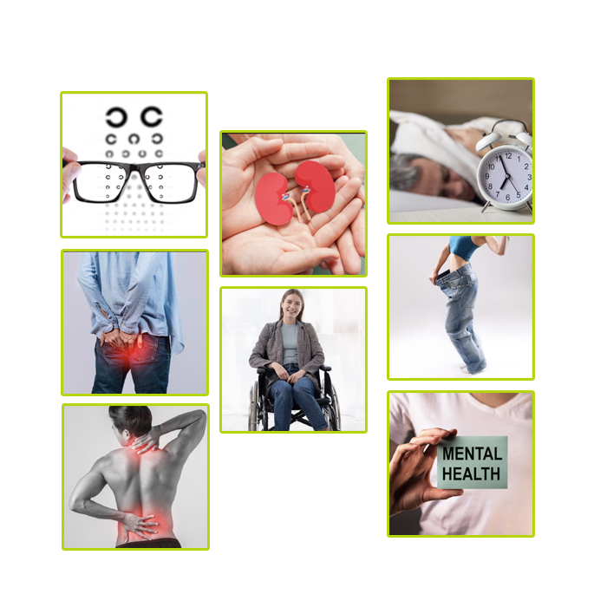
Treatments we currently offer under AYUSH Club
Kidney Treatments
Liver Problems
Skin and Hair Treatment
Autoimmune Disorders
UTI Problems
Piles Treatment
Sexual Wellness
ENT Problems
Paralysis
Lifestyle Disorders
Endocrine Problems
Mental Health Support
Pain Management
Cancer Support
Panchakarma Treatment
Weight Loss and Obesity Support
Body De-Toxification
Immunity Enhancement Therapies
Eye Care
Gastric Problems
Women's Health and PCOS
Sleep Disorder
Acupuncture Therapy
Arthritis and Rheumatoid Arthritis Treatment
Range of Ayurvedic Treatments

Slide 21
The support we need from the Ministry of AYUSH
Training from the experts – Even though we have done our part of the research work about AYUSH and already working with it, it would be a great support if we receive proper training from the professionals about the benefits, services, therapies, and other important information relating to AYUSH medicines. Being entrepreneurs, the better equipped we are with AYUSH, the stronger team we can build to promote AYUSH on a larger and more established scale.
Approval from the Ministry to continue work on a domestic and global stage – Thanks to our hard work and experience in the field, we have not only established our place in India but also hold a strong network abroad. We already have our teams working in Bangladesh and Nigeria currently and also have our presence in several other countries. Additionally, we are working to expand to other nations as well very soon. Thus, we would like to promote AYUSH therapies to these nations we are working in.
Funding – Funds are a crucial point when it comes to expanding and growing a business. With expansion comes expenses, in marketing, building qualified teams, maintaining employees, and establishing centers to do work. Thus, we need funding support from the ministry to help us grow and prosper through our activities under AYUSH Club.

Slide 22
If India plays its cards right and the efforts of the government hit the bull’s eye, India can stand out on the world stage as the global healthcare leader through AYUSH.
AYUSH practices becoming mainstream come with a number of benefits such as:
Healthcare shall become more easily accessible and affordable to all sections of society, especially those who struggle to pay their medical bills.
Comparatively minor issues like piles, pain, stress, skin and hair problems, eye care, gastric issues, sleep disorder, obesity, etc. as well as major diseases like kidney and liver problems can be cured through AYUSH therapies. This will help reduce the pressure on both the healthcare industry and the patients. The patient shall have lesser bills to pay while the hospitals and doctors will have even if not much, a slightly lesser number of patients to worry about.
If recognized globally, India will become a leading player in the traditional medicine market since the roots of AYUSH originate here.
AYUSH therapies and medicines come from nature, hence they are easier to trust and good for our Mother Earth.
Compared to allopathy and Western medicine, although it works slowly AYUSH therapies heal from within, making it even more vital for the healthcare sector.
Hence, we need to work together to unleash the true potential of the Indian holistic approach to traditional medicine. We are committed to the cause of 'New India' becoming Healthy India' and look forward to contributing to its success story in the time to come.

